Slide 1
Welcome
Brighton Ballet Theater & the Students of PS 215 Morris H. Weiss Elementary School
are glad to present to you
Peter and the Wolf by Prokofiev
& the Dance Presentation
Production and Choreography by
Ana Lejava, Irina Lepteva
Artistic Director : Irina Roizin
Sponsored by the CASA Program

Slide 2

Who we are

Slide 3
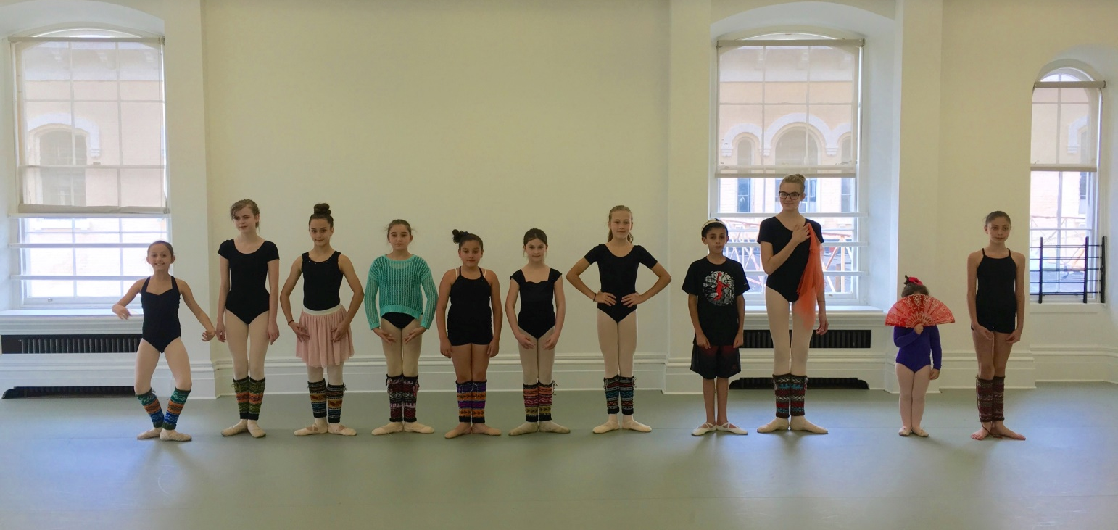
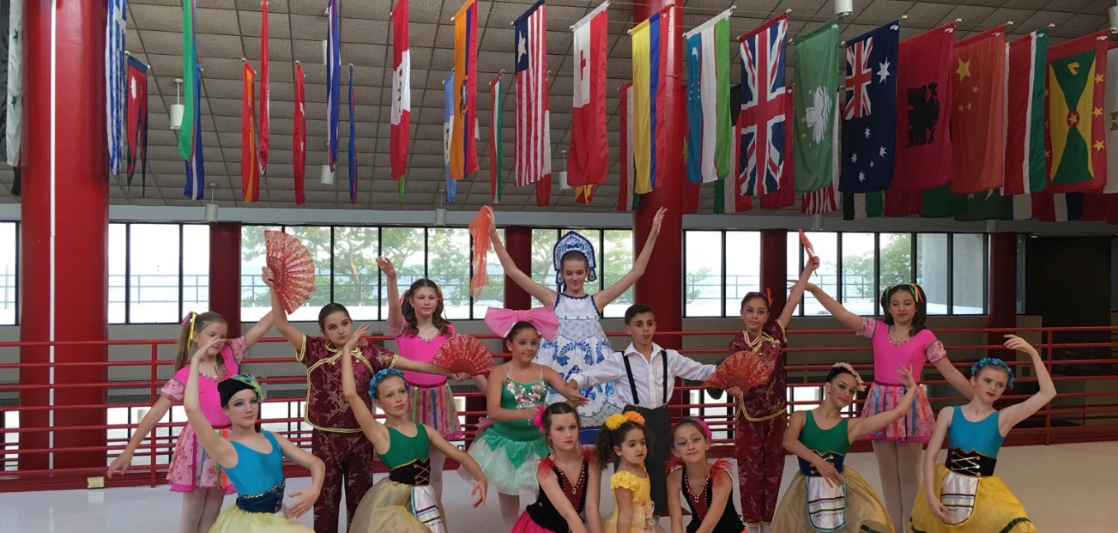
School of Russian American Ballet

Slide 4
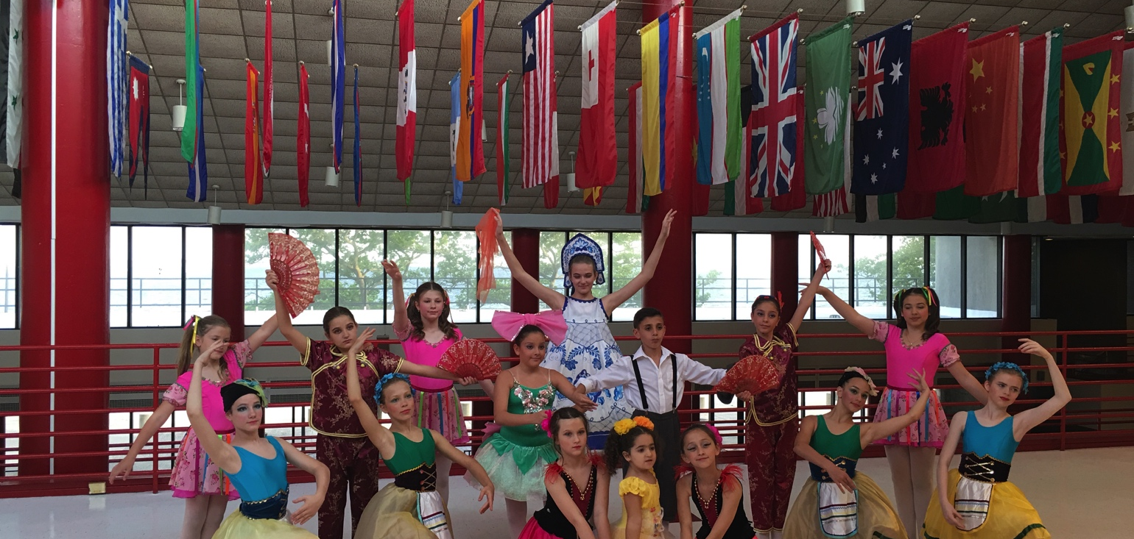
Brooklyn & Staten Island Division students all come together for the BBT’s Annual Winter & Spring Performances

Slide 5
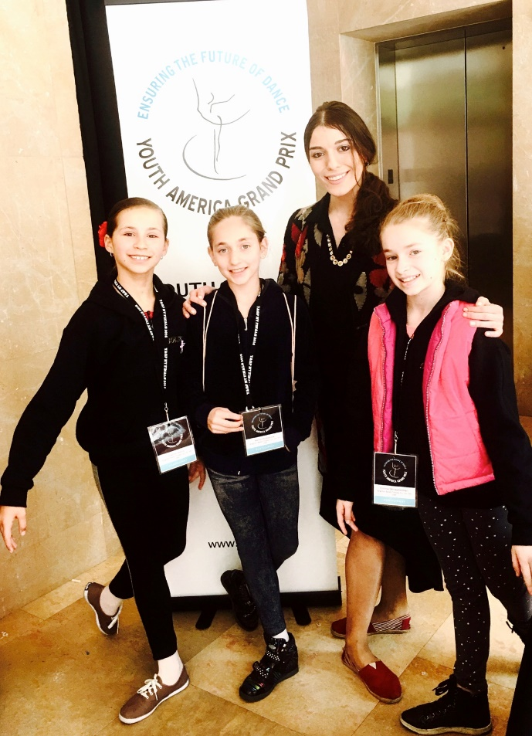
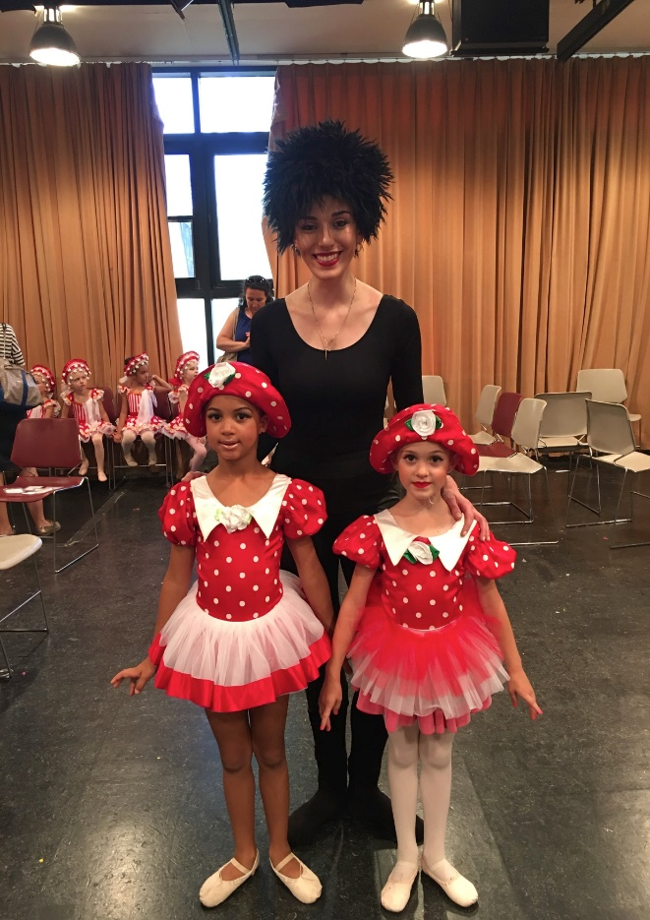
We teach to all ages and all levels of dance technique….

Slide 6
Afterschool program
Second year of the BBT afterschool program at PS 215 Morris H. Weiss Elementary School.
First and Second grades learning basics of ballet, appreciation of the dance arts, and acting skills, all leading to their production of the Small Story Ballet “Peter and the Wolf”
Thank you to NEW YORK CITY DEPARTMENT OF CULTURAL AFFAIRS and THE CITY COUNCIL for their continuous support.
Many Thanks to the PS 215 principle and assistant principle: Antonella Bove Ellen Resnick

Slide 7
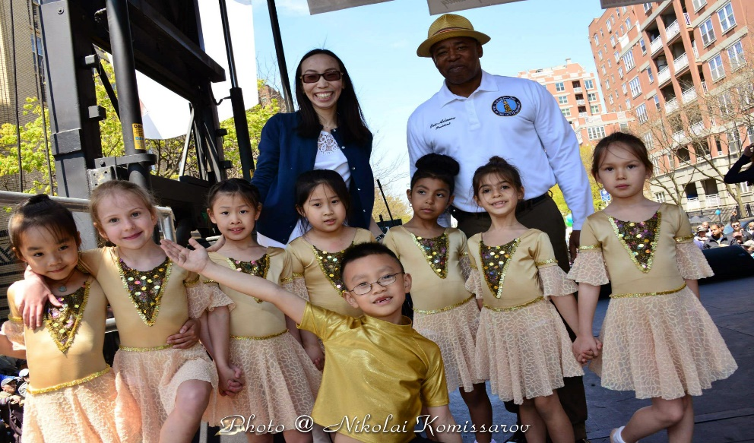
Notes:
Teacher Prompt:
The music sounds like Peter is afraid; unafraid (Circle one option)

Slide 8
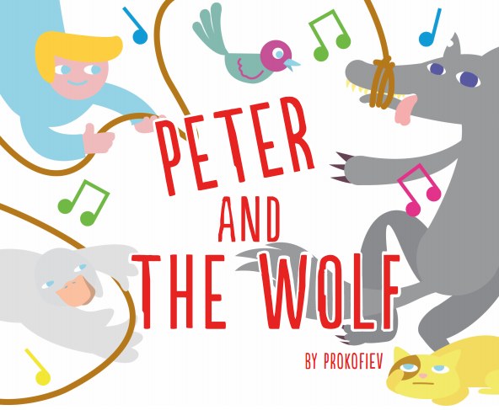

Slide 9
Prokofiev & His Story
In 1936, the Children’s Theatre in Moscow asked Prokofiev to write a new symphony for children. They wanted a piece of music that would appeal to children and create an interest in orchestral music. Prokofiev wrote the story and music in just four days! It was first performed in 1936 but did not attract very much attention. Today, it is one of the most well-known and well-loved pieces of orchestral music.

Slide 10
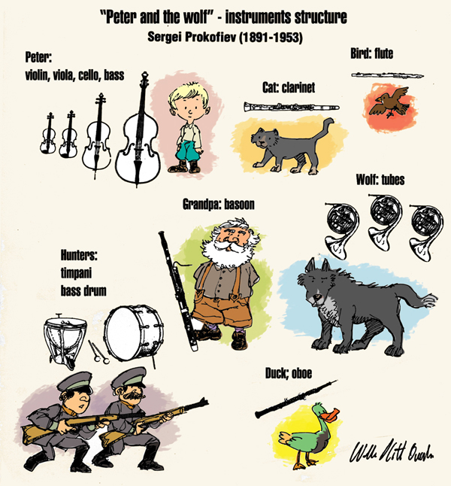

Slide 11
Symbolism & Zeitgeist
Story is Simple and Easy to Understand for the Children, however it caries few important messages and lessons
Peter lives in the country with his grandfather. His grandfather tells Peter not to play in the meadow, because a wolf lives in the forest, but Peter does not listen. He leaves the gate open and goes into a green meadow. Little ducklings follow Peter, when the see that gate is open. In the meadow Peter meets and plays with the birds, cat, butterfly and little ducklings. The wolf comes out of the forest into the meadow and eats the duck. Peter is brave and, with the help of the cat and birds, he catches the wolf. Hunters help him put the wolf into a cage and take him to the zoo. Grandfather is very surprised when he sees what Peter has done.

Slide 12
Cast & Characters
Peter and his friend: Britanny Liang & Anna Vagele
Wolf - Elizabeth Strakovsky
Birds - Sofia Mdahe, Sheen Lola Heady,
Alexia E. Matskevich, Felicia Chan,
Elizabeth Razpopova, Jing Hueng
Ducklings - Vivian Lin, Leyla Laruiocco Heady
Butterfly - Farangiz Majitova
Cat - Gabriela Gonzalez
Hunters - Emily Portuov
Isabella Goicoechea
Lorie Sobieszczuk,
Sherlyn Hernandez,
Grandmother - L.A. Ruocco Heady
Notes:
Teacher Prompt:
The Grandfather sounds like the bassoon; flute (Circle one option)

Slide 13
Thank you for coming and enjoy the performance
@ Brooklyn, NYC 2016
Notes:
Teacher Prompt:
Grandfather’s music sounds as if he is walking; running (Circle one option)

Slide 14
Notes:
Teacher Prompt:
The wolf sounds like a French horn; drum (Circle one option)

