Slide 1
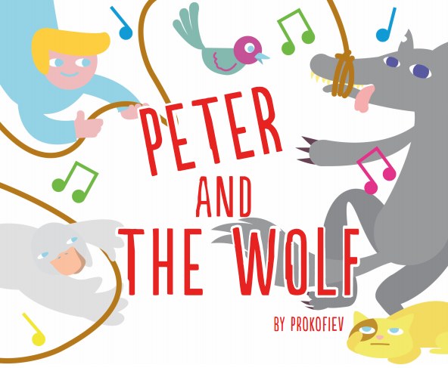

Slide 2
Resources needed
CD/audio track of Peter and the Wolf by Sergei Prokofiev
Peter and the Wolf listening map
Instrument posters
Pencil per child

Slide 3
Instructions
The following is the story of Peter and the Wolf.
As you listen to the musical composition, read the “teacher prompts” which correspond to the numbered panels on the Listening Map.
Visual cues on the map relate to concepts found in the music and/or narration.
Where there are two choices, students should be asked to choose one and circle the picture representing their choice. A “pencil” in the panel means students should draw a line representing the shape of the musical idea they hear, such as a bird’s flight.
The teacher should help students at each panel by using the “teacher prompt” to elicit a response; you may even want to stop the CD occasionally as needed or even listen to sections more than once and discuss as a class what is heard.

Slide 4
1. Early one morning, Peter opened the gate and went out into a big, green meadow.
(Peter’s theme)
Notes:
Teacher Prompt:
The music sounds like Peter is: skipping; standing (Circle one option)

Slide 5
2. On the branch of a big tree sat a little bird, Peter’s friend... “All is quiet” chirped the bird happily. (Bird theme)
Notes:
Teacher Prompt:
The bird sounds like the flute; tuba (Circle one option)

Slide 6
3. Soon a duck came waddling around. She was glad that Peter had not closed the gate. She decided to take a nice swim in the deep pond in the meadow.
(Duck theme)
Notes:
Teacher Prompt:
The duck sounds like the violin; oboe (Circle one option)

Slide 7
4. Seeing the duck, the little bird flew down upon the grass, settled next to the duck and shrugged her shoulders. “What kind of bird are you if you can’t fly? said she. To this, the duck replied “what kind of bird are you if you can’t swim?” and dived into the pond.
Notes:
Teacher Prompt:
Draw a line showing the movement of the duck. Draw another line showing the movement of the bird.

Slide 8
5. They argued and argued – the duck swimming in the pond, the bird hopping on the shore.
Notes:
Teacher Prompt:
Draw lines showing the duck (oboe) and the bird (flute) having an argument.

Slide 9
6. Suddenly, something caught Peter’s attention. He noticed a cat crawling through the grass.
Notes:
Teacher Prompt:
The cat sounds like the double bass; clarinet (Circle one option)

Slide 10
7. The cat thought, “The bird is busy arguing…I’ll just grab her.” Stealthily, she crept toward the bird on her velvet paws.
Notes:
Teacher Prompt:
The sound of the creeping cat is loud; soft (Circle one option)

Slide 11
8. “Look out!” shouted Peter, and the bird immediately flew up into the tree.
Notes:
Teacher Prompt:
Draw the bird flying up into the tree.

Slide 12
9. The duck quacked angrily from the middle of the pond.
Notes:
Teacher Prompt:
Draw a quacking duck in the pond.

Slide 13
10. The cat stalked around the tree and thought “Is it worth climbing up so high? By the time I get there, the bird will have flown away.”
Notes:
Teacher Prompt:
I hear the cat; bird; duck (Circle two options)

Slide 14
11. Grandfather came out. He was angry because Peter had gone to the meadow. “It is a dangerous place…If a wolf should come out of the forest, then what would you do?”
Notes:
Teacher Prompt:
The Grandfather sounds like the bassoon; flute (Circle one option)

Slide 15
12. Peter paid no attention to Grandfather’s words. Boys like him are not afraid of wolves.
Notes:
Teacher Prompt:
The music sounds like Peter is afraid; unafraid (Circle one option)

Slide 16
13. But Grandfather took Peter by the hand, led his home, and locked the gate.
Notes:
Teacher Prompt:
Grandfather’s music sounds as if he is walking; running (Circle one option)

Slide 17
14. No sooner had Peter gone when a big, grey wolf came out of the forest.
Notes:
Teacher Prompt:
The wolf sounds like a French horn; drum (Circle one option)

Slide 18
15. The cat climbed quickly up the tree.
Notes:
Teacher Prompt:
Draw a line showing the cat climbing up the tree

Slide 19
16. The duck quacked and in her excitement jumped out of the pond.
Notes:
Teacher Prompt:
Draw the duck jumping out of the pond.

Slide 20
17. But no matter how hard the duck tried to run, she couldn’t escape the wolf. He was getting nearer…nearer…catching up with her…and then…he got her. With one big gulp, he swallows her.
Notes:
Teacher Prompt:
When the wolf chases the duck, the music gets faster; slower (Circle one option)

Slide 21
18. And this is how things stood: the cat was sitting on one branch, the bird on another, not too close to the cat.
Notes:
Teacher Prompt:
I hear the trumpet; clarinet; flute (Circle two options)

Slide 22
19. The wolf walked around and around the tree looking at them with greedy eyes.
Notes:
Teacher Prompt:
Listen carefully. I hear the wolf along with this percussion instrument: cymbal; jingle bells (Circle one option)

Slide 23
20. In the meantime, Peter, without the slightest fear, stood behind the closed gate watching all that was going on.
Notes:
Teacher Prompt:
Draw Peter’s expression as he looks over the gate.

Slide 24
21. Peter ran home, took a strong rope and climbed up the high, stone wall. One of the branches of the tree around which the wolf was walking stretched out over the wall.
Notes:
Teacher Prompt:
I can hear Peter’s actions played by the violins; French horns (Circle one option)

Slide 25
22. Grabbing a hold of the branch, Peter lightly climbed over onto the tree. Peter said to the bird, “Fly down and circle around the wolf’s head. Take care that he doesn’t catch you.”
Notes:
Teacher Prompt:
Draw a line showing the bird’s flight around the wolf’s head.

Slide 26
23. The bird almost touched the wolf’s head with her wings while the wolf snapped angrily at her from this side and that. Surprise!
Notes:
Teacher Prompt:
Count the number of times the wolf snaps at the bird and write the number in box 23.

Slide 27
24. Gosh, the bird really worried the wolf. He wanted to catch her. The bird was clever and the wolf couldn’t do anything about it. Meanwhile, Peter made a lasso and carefully lowered it down. He caught the wolf by its tail and pulled with all his might.
Notes:
Teacher Prompt:
What sounds represent the lasso? Violin (strings); bassoon (woodwind) (Circle one option)

Slide 28
25. Feeling himself get caught, the wolf began to jump wildly trying to get loose.
Notes:
Teacher Prompt:
The music sounds heavy; light (Circle one option)

Slide 29
26. Peter tied the other end of the rope to the tree. The wolf’s jumping only made the rope around his tail tighter.
Notes:
Teacher Prompt:
Listen carefully. When the wolf jumps around, I hear the flute; snare drum (Circle one option)

Slide 30
27. Just then the hunters came out of the woods following the wolf’s trail and shooting as they went.
Notes:
Teacher Prompt:
The music sounds like the hunters are running; marching (Circle one option)

Slide 31
28. But Peter, sitting in the tree said “Don’t shoot!” Birdie and I have already caught the wolf. Now, help us take him to the zoo.
Notes:
Teacher Prompt:
The music makes me feel like ballet dancing; stomping boots (Circle one option)

Slide 32
29. Imagine the triumph and parade with Peter at the head.
Notes:
Teacher Prompt:
The music sounds like Peter is running; walking (Circle one option)

Slide 33
30. After Peter, the hunters are leading the wolf and winding up the parade is Grandfather and the cat. The Grandfather shook his head and said “Well! And if Peter hadn’t caught the wolf, what then?”
Notes:
Teacher Prompt:
Circle each character as you hear his music OR the instrument that has played his theme during the story.

Slide 34
31. Above them, birdie flew chirping merrily, “My, what fine ones, Peter and I! Look what we have caught!”
Notes:
Teacher Prompt:
Draw a line showing the bird’s movements.

Slide 35
32. And if one would listen very carefully, he could hear the duck quacking in the wolf’s belly because in his hurry, he had swallowed her alive.
Notes:
Teacher Prompt:
Draw the duck in the wolf’s belly.

